Slide 1
Potato leaf disease detection
Minor project presentation
By –
Aditya Goyal (BETN1CS19078)
Aman Gupta (BETN1CS19079)
Shivam Shukla (BETN1CS19099)

Slide 2
TOPIC
POTATO LEAF DISEASE CLASSIFICATION
USING
CONVUTIONAL NEURAL NETWORK
(CNN)

Slide 3
Introduction
We will develop an End to End project which will be
based on Pure Deep Learning.
The reason behind building this project is to detect
or identify potato leaf diseases, having a variety of
illnesses. Because our naked eyes can’t classify them,
but Convolutional Neural Network(CNN) can easily.

Slide 4
Problem Statement
Farmers who grow potatoes suffer from serious financial losses each year which cause several diseases that affect potato plants.
Potato leaf disease detection in an early stage is challenging because of variations in crop species, crop diseases symptoms and environmental factors.These factor make it difficult to detect potato leaf diseases in the early stage.

Slide 5
Types of diseases
Bacterial wilt.
Septoria leaf spot.
Late blight.
Early blight.
Common scab.
Blackscurf/canker.

Slide 6
The most frequent diseases in potato leaf are :-
Early Blight
Late Blight

Slide 7
Early blight :
Early blight is caused by fungus.

Slide 8
Late blight :
Late blight is caused by specific micro-organisms.

Slide 9
If farmers detect this disease early and apply
appropriate treatment then it can save a lot
of waste and prevent economical loss.
The treatments for early blight and late
blight are a little different so it’s important
that we accurately identify what kind of
disease is there in that potato plant.

Slide 10
Project Description
We are going to use Convolutional Neural Network - Deep Learning to diagnose plant diseases.
We’ll develop an end-to-end Deep Learning project in the field of agriculture. We will create a simple Image Classification Model that will categorize Potato Leaf Disease using a simple and classic Convolutional Neural Network Architecture.

Slide 11
Why CNN for Image Classification?
Image classification involves the extraction of features from the image to observe some patterns in the dataset. Using an ANN for the purpose of image classification would end up being very costly in terms of computation since the trainable parameters become extremely large.

Slide 12
This project can broken down into some steps :
Data Collection
Data Cleaning & Data Preprocessing
Model building
Model deployment

Slide 13
Data Collection
Any Data Science project start’s with the process of acquiring the data. First, we need to collect data. We have 3 options for collecting data
we can use readymade data we can either buy it from a third-party vendor or get it from Kaggle etc.
we can have a team of Data Anatator whose job is to collect these images from farmers and annotate those images either healthy potato leaves or having early or late blight diseases. So this team of annotators works with farmers, go to the fields and they can ask farmers to take a photograph of leaves or they can take photographs themselves and they can classify them with the help of experts from agriculture field. So they can manually collect the data. But this process will be time-consuming.

Slide 14
writing a web-scraping script to go through different websites which has potato images and collect those images and use different tools to annotate the data.
In this project, I am using readymade data that I got from Kaggle and ATLIQ (Agriculture)

Slide 15
In this dataset we have three types of images:
Healthy Early Blight Late Blight

Slide 16
Data Cleaning & Data Preprocessing
Pre-processing data aims to improve the quality of data
to realize an accurate training model output. The first step is
to minimize the noise in the image, and if there is excessive
noise in the image, then it will not be used. Acquired images
have a variety of sizes, and images are resized to Same
pixels to standardize the input of images in datasets

Slide 17
Model building
Loading the Dataset.
Build a Simple and classical Convolutional Neural
Network Architecture.
Our dataset is preprocessed and now we are ready to build our model. We are going to
use a Convolutional Neural Network which is one of the famous types of Neural Network
Architecture if you are solving Image Classification Problems. Here we are creating simple
and classical Neural Network Architecture. Here we are using Keras Sequential API to create
our model architecture, it only contains a stack of convolutional and pooling layers. There is
approx n number of layers and then at the end, there is a dense layer where we just flatten our
feature maps. In the end, we are using a dense layer with a softmax activation function, which
will return the likelihood of each class.

Slide 18
Compile the Potato Leaf Disease Prediction model
Train the network
Testing Model
Save the Model

Slide 19
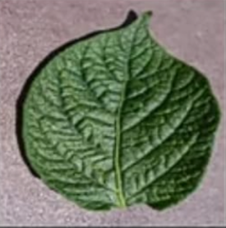
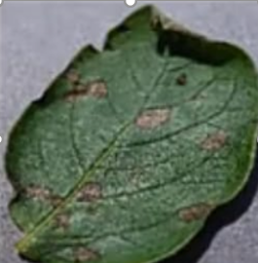
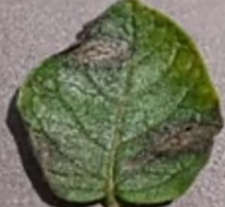
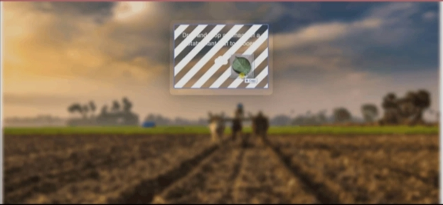
Data cleaning &
preprocessing
Model Building
Tf serving
Tf dataset
CNN
https://localhost:8501
Data augmentation
FastAPI
http://locahost:8000
React JS

Slide 20
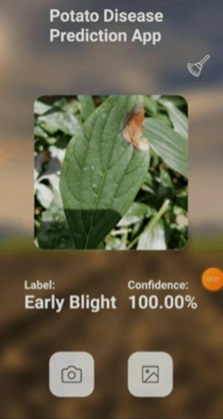


Data cleaning &
preprocessing
Model Building
Tf lite model
Quantization
Tf dataset
CNN
Data augmentation
Google cloud Functions
React Native
GCP

Slide 21
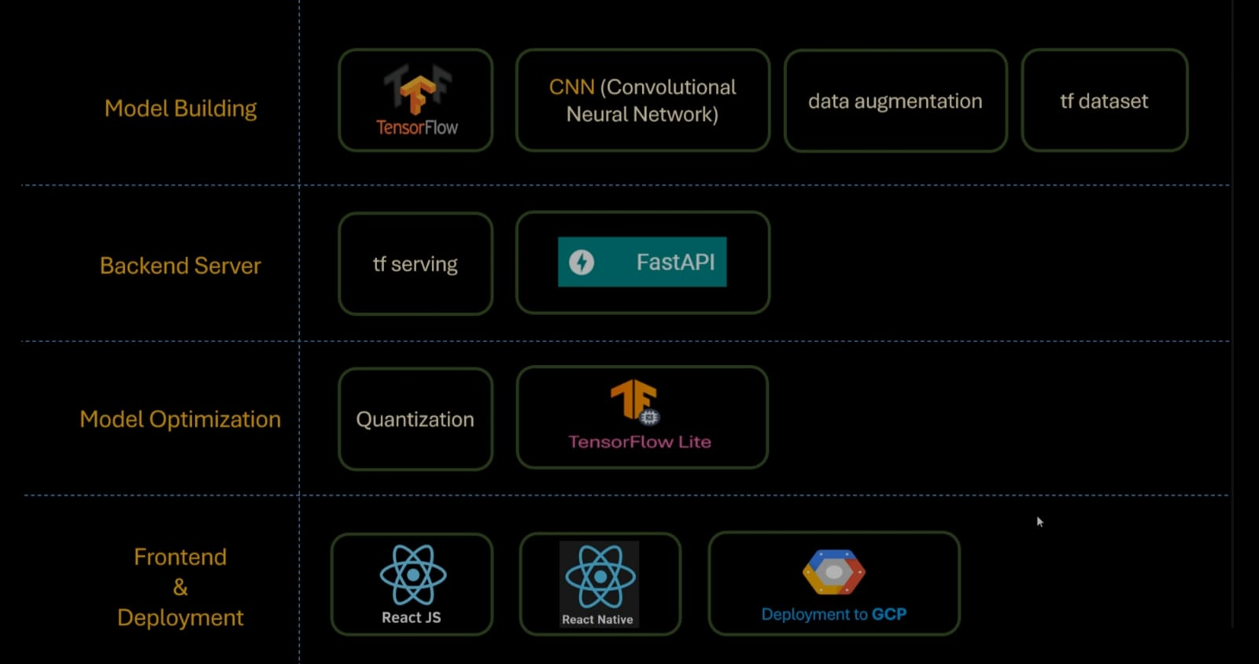

Slide 22
Thank You

